Slide 1

The Future of Computer-assisted Education

Slide 2
Objectives
What is Computer-Assisted Education
How does it work?
Growth of internet-based learning
Education 4.0
Smart Classes
Benefits and Drawbacks
Findings and Analysis
KEY-WORDS: Education, Teachers, Smart classes, Videos, Technology.

Slide 3
What is Computer-Assisted Education?
Use of electronic devices to gain knowledge, and information.
Requires no human intervention.
Strategy to make teaching more sustainable.
Provide access to educational resources and opportunities.

Slide 4
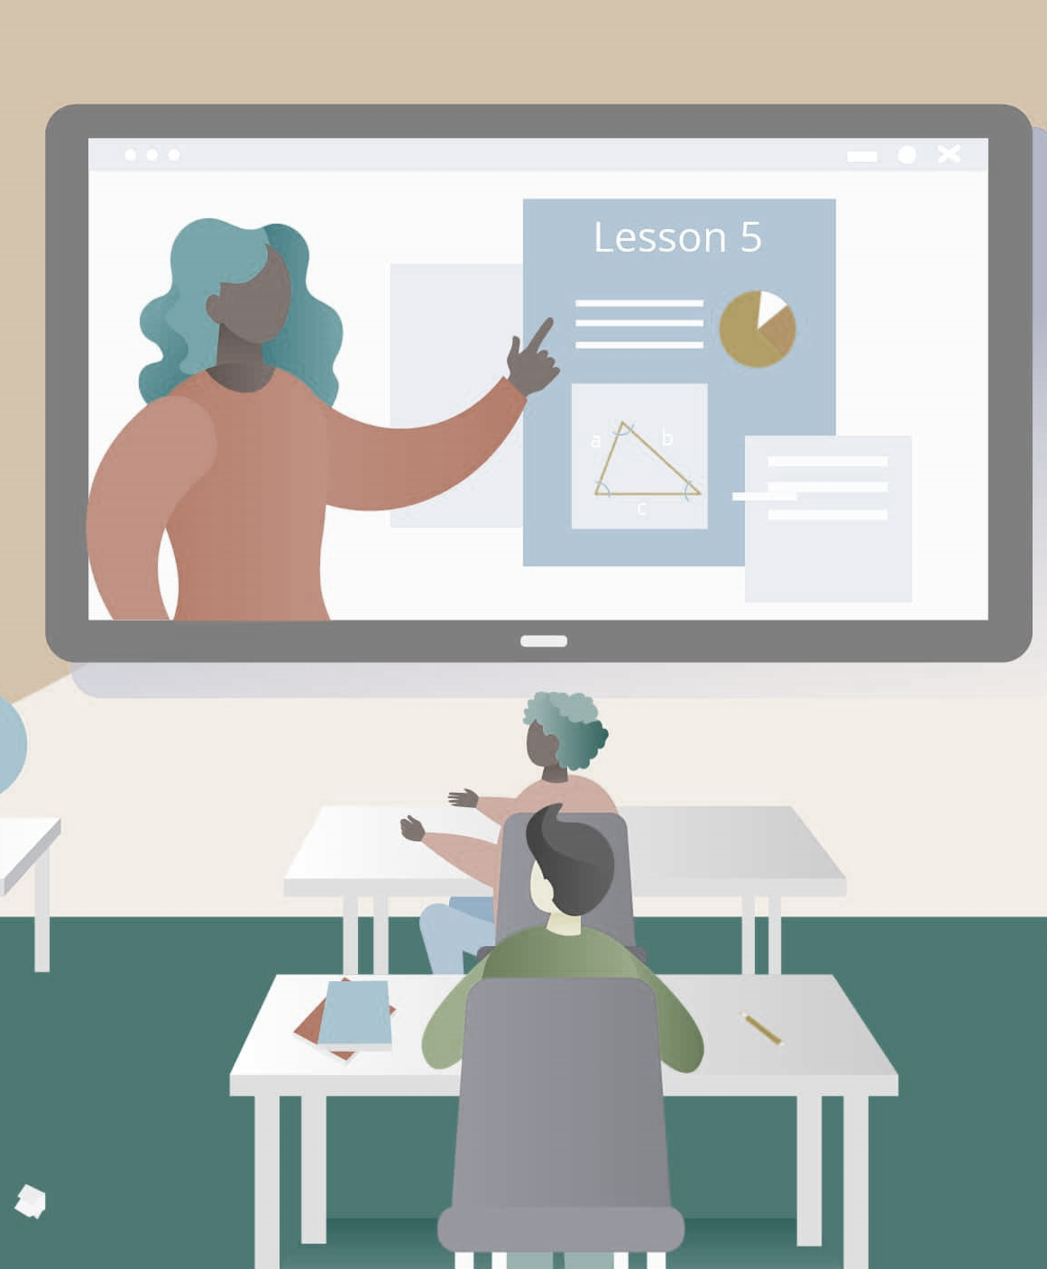

How does It work
Adaptive learning
Collaboration and communication
Feedback and assessment
Access to resources
Delivery of content

Slide 5
Growth of Internet-based learning
Online learning has shown significant growth over the last decade.
Since the COVID-19 outbreak, online learning has become more centric in people's lives.
The pandemic has forced schools, and universities to remote working.
Research and Markets forecasts the online education market worth $350 Billion by 2025.
Numerous online learning platforms in the market:
Udemy
Coursera
Lynda

Slide 6
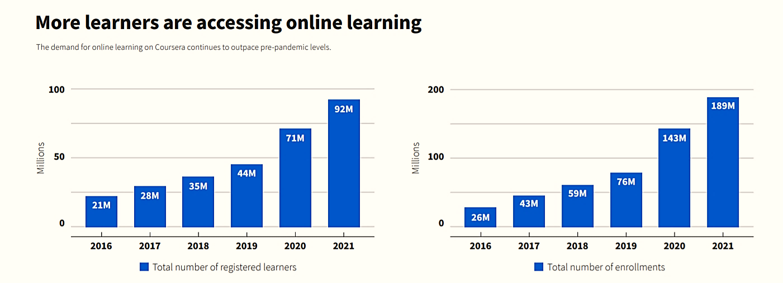

Slide 7

Source: UNESCO

Slide 8
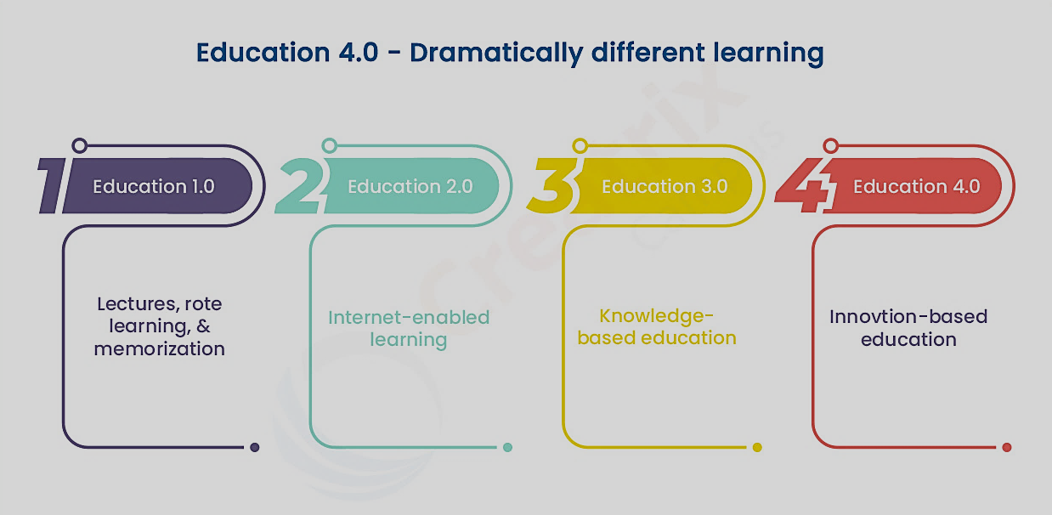
Education 1.0 vs 4.0

Slide 9


Smart Classes
Platform to Bring teams together, reimagine workspaces, engage new audiences.
teachers and students connect and collaborate together.
A platform made by Google, it helps connect school communities with classes, parent-teacher conferences and more.

Slide 10
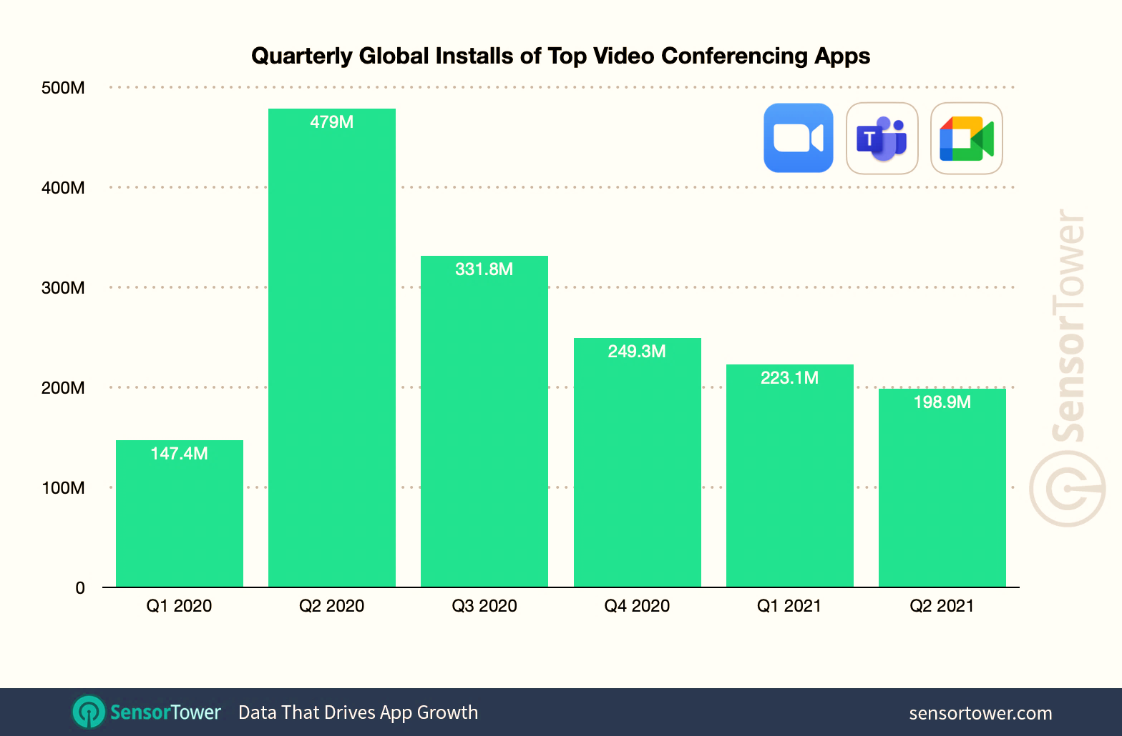

Slide 11

Benefits
Improved learning outcome.
Enhanced Engagement
Helps student to see daily progress
Increases Accessibility
Time efficiency
Flexibility.

Slide 12

Drawbacks
Distraction
Isolation
It Can Be Expensive
Quality of content

Slide 13
Findings & Analysis
It has been analyzed that computer assisted education doesn’t mean eliminating teachers.
Computers aren’t restricted to one field of education but are open to all areas of education from science to medical.
Virtual class rooms can be created anywhere any time.
Teaching institutes have adopted new teaching ways such as intelligent boards.
About 86% of educators told that they use laptops in classrooms.

Slide 14


Conclusion
According to our research, computer-assisted education is the most efficient method of teaching and is found to be significant as it increases the interest of students and enhances their motivation level.

Slide 15


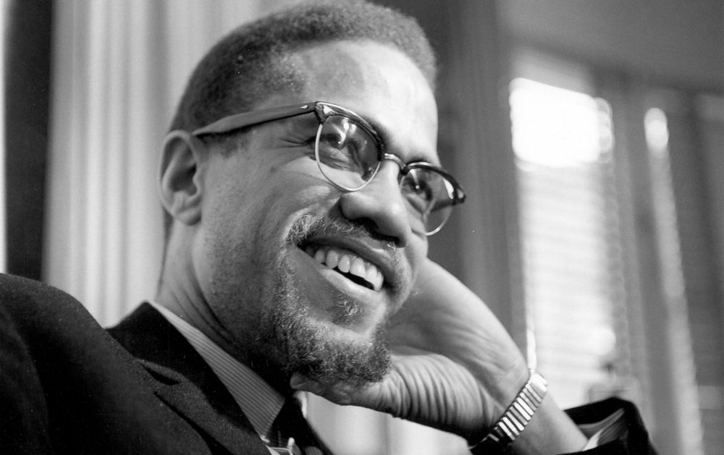
Education is the passport to the future, for tomorrow belongs to those who prepare for it today.
Malcolm X

Slide 16
Thank You!

